Slide 1
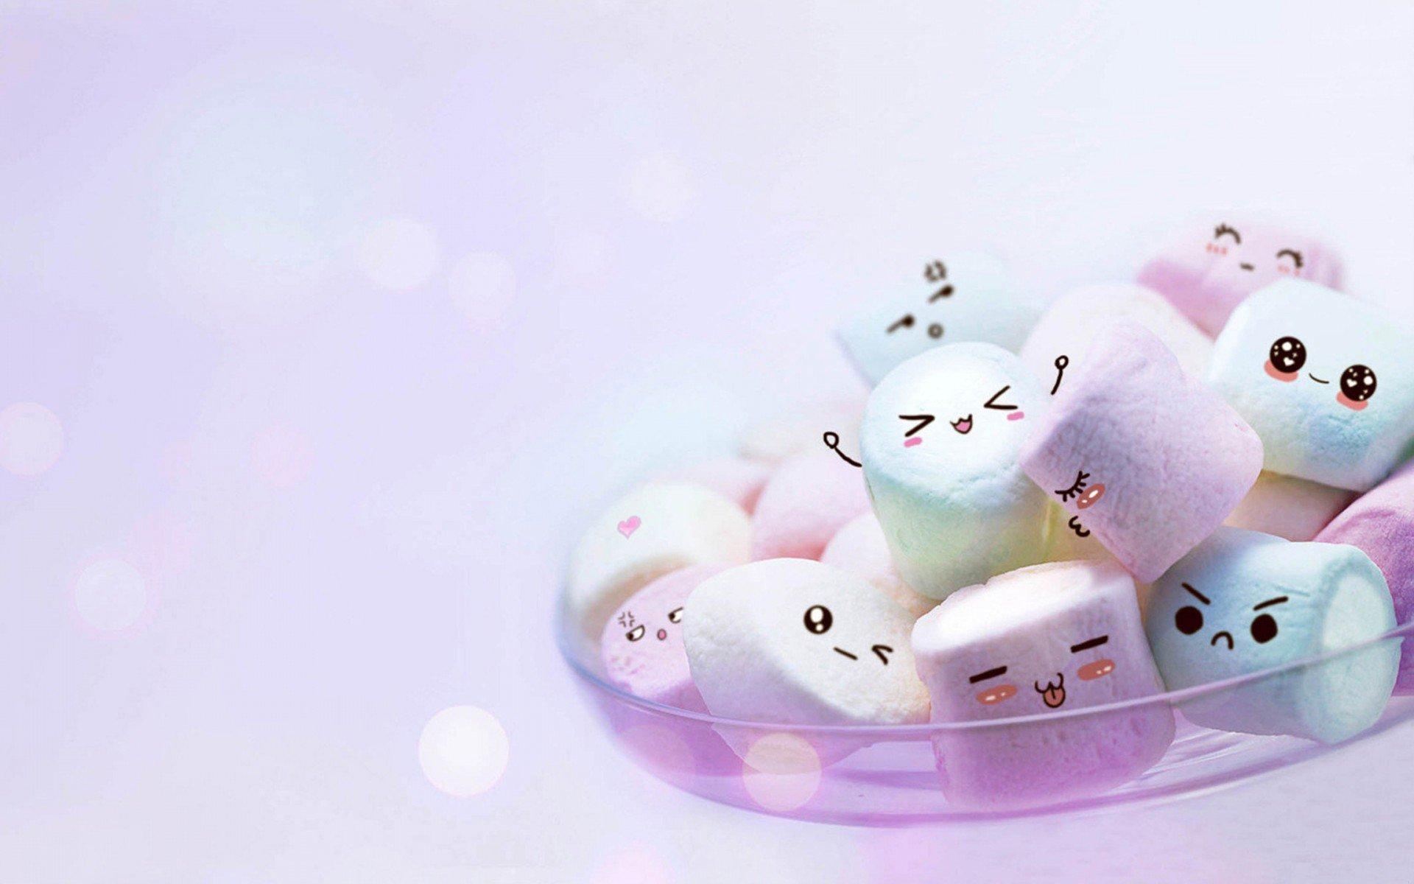

Slide 2
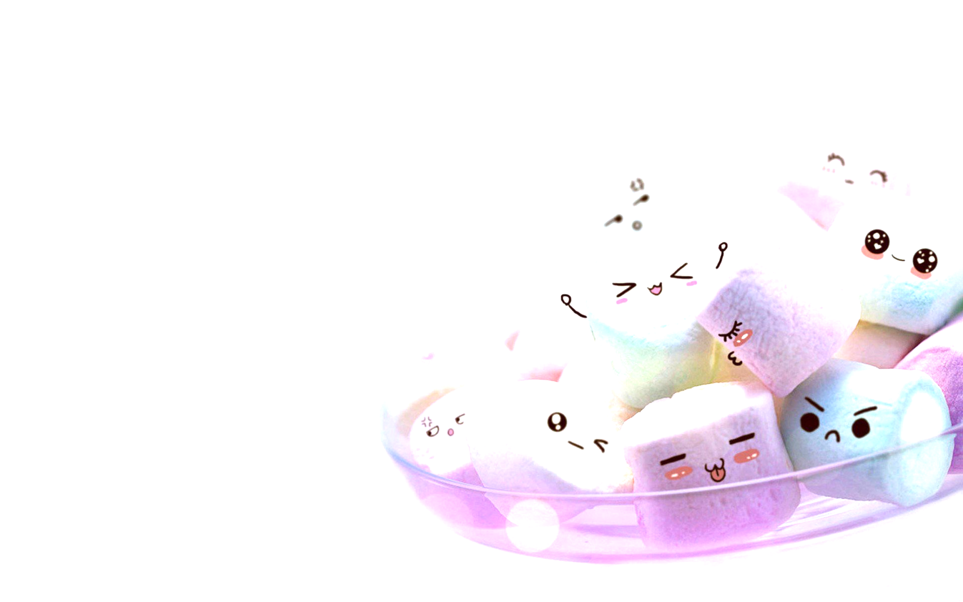
ICE BREAKER
THE CANDY GAME
‹#›
Red: What’s your favorite book?
Blue: What is your favourite kind of food?
Green: TV show you are addicted to?
Orange: Best vacation spot you have been to?
Yellow: Favourite part of your work week?
Brown: If you could have any super hero quality what would it be?

Slide 3
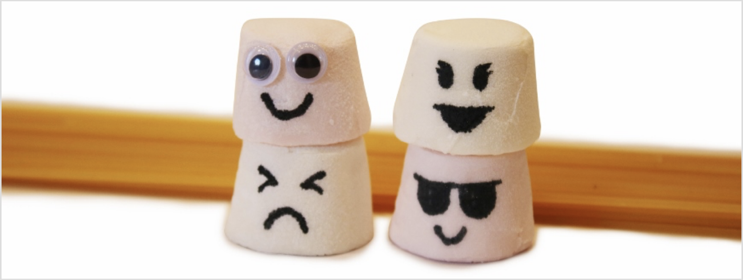
The Marshmallow Challenge
Team Bonding & Building
‹#›

Slide 4
‹#›
WIIFM..
Collaboration
How to be innovative and creative
Most importantly shows how to work together

Slide 5
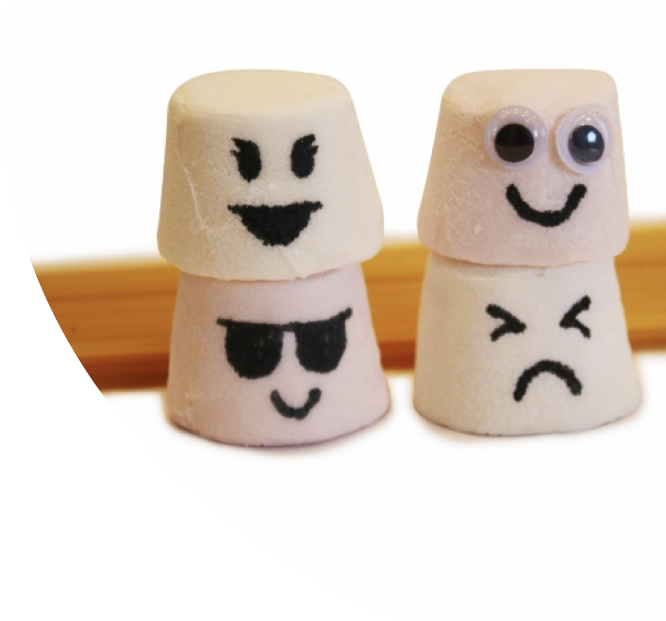
‹#›
The challenge is..
To build
The tallest
Free standing structure
With a marshmallow on top

Slide 6
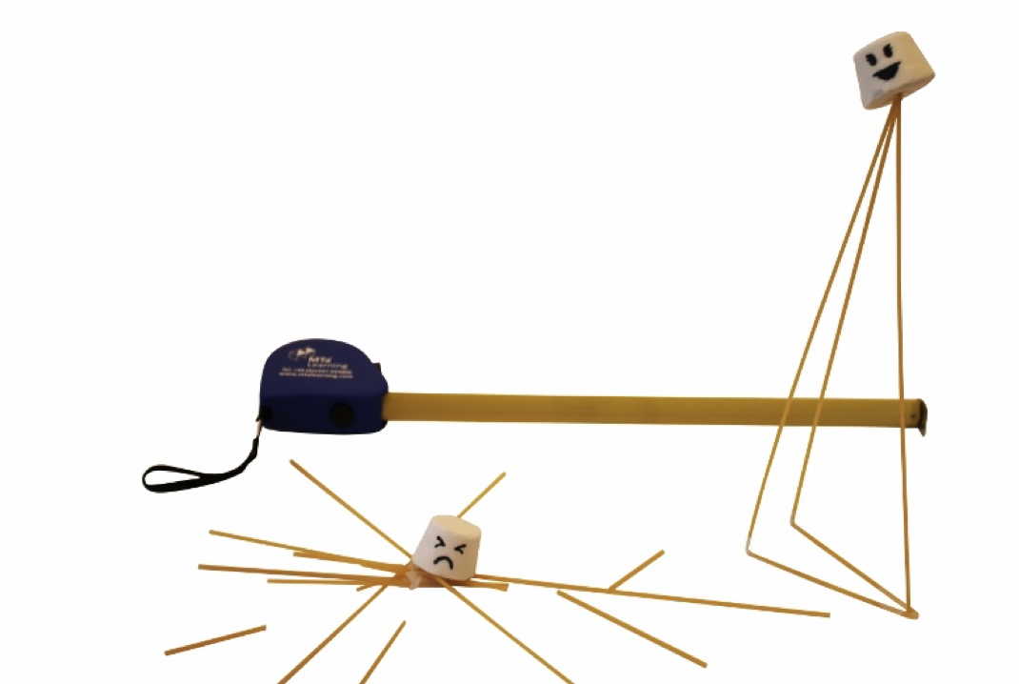
‹#›
Rules..
Use only the resources provided.
You cannot combine with other teams.
The tower must be freestanding.
Your tower should support a single marshmallow.
The marshmallow must be the highest point of the structure.
You have ⏳18 minutes to complete this challenge.

Slide 7
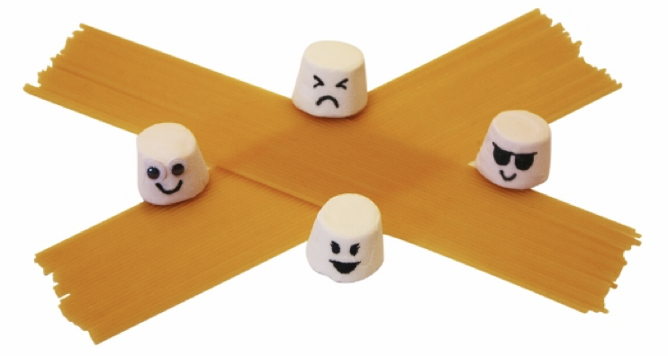
‹#›
Resources provided..
Masking tape
String
20 sticks of thin spaghetti
1 new, never eaten marshmallow :)

Slide 8
‹#›
Teams..
Team 1
Qas
Madhuri
Suneetha
Team 2
Sri
Bushra
Ravi

Slide 9
‹#›
Wrap up..
How did that go?
How did you feel?
Was there any pressure?
What really worked for you?
Did you do a lot of planning?
Winning Team: Why is it that you did really well?
Losing Team: What was hindering your team to perform effectively.
What are the key learnings you can taken away from this activity?
How can you apply this learnings to improve your team and individual performance?

